Slide 1
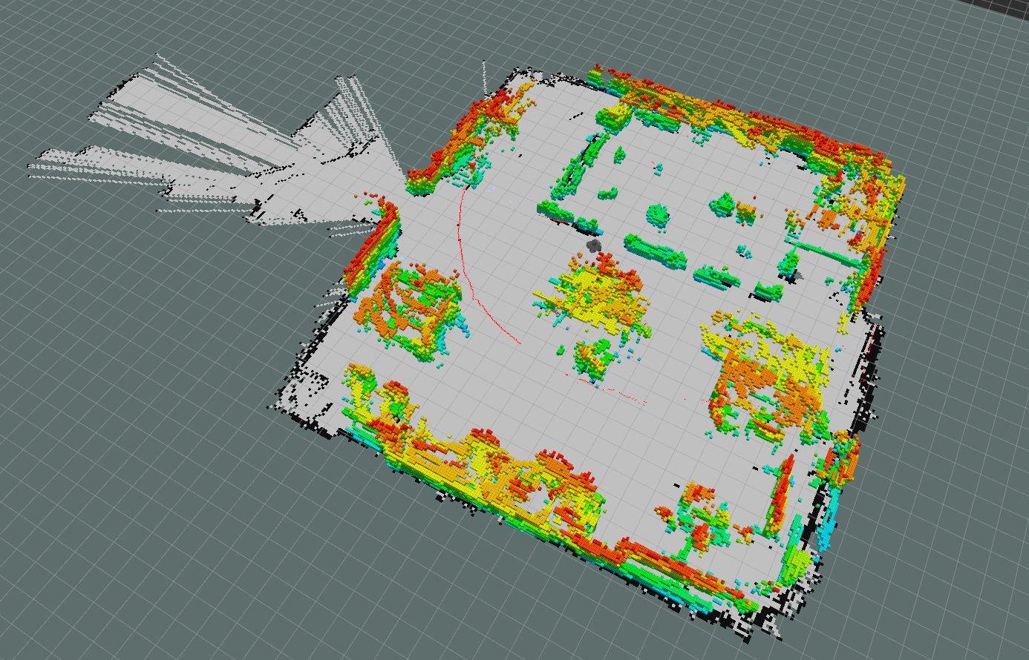
Project #3

Slide 2
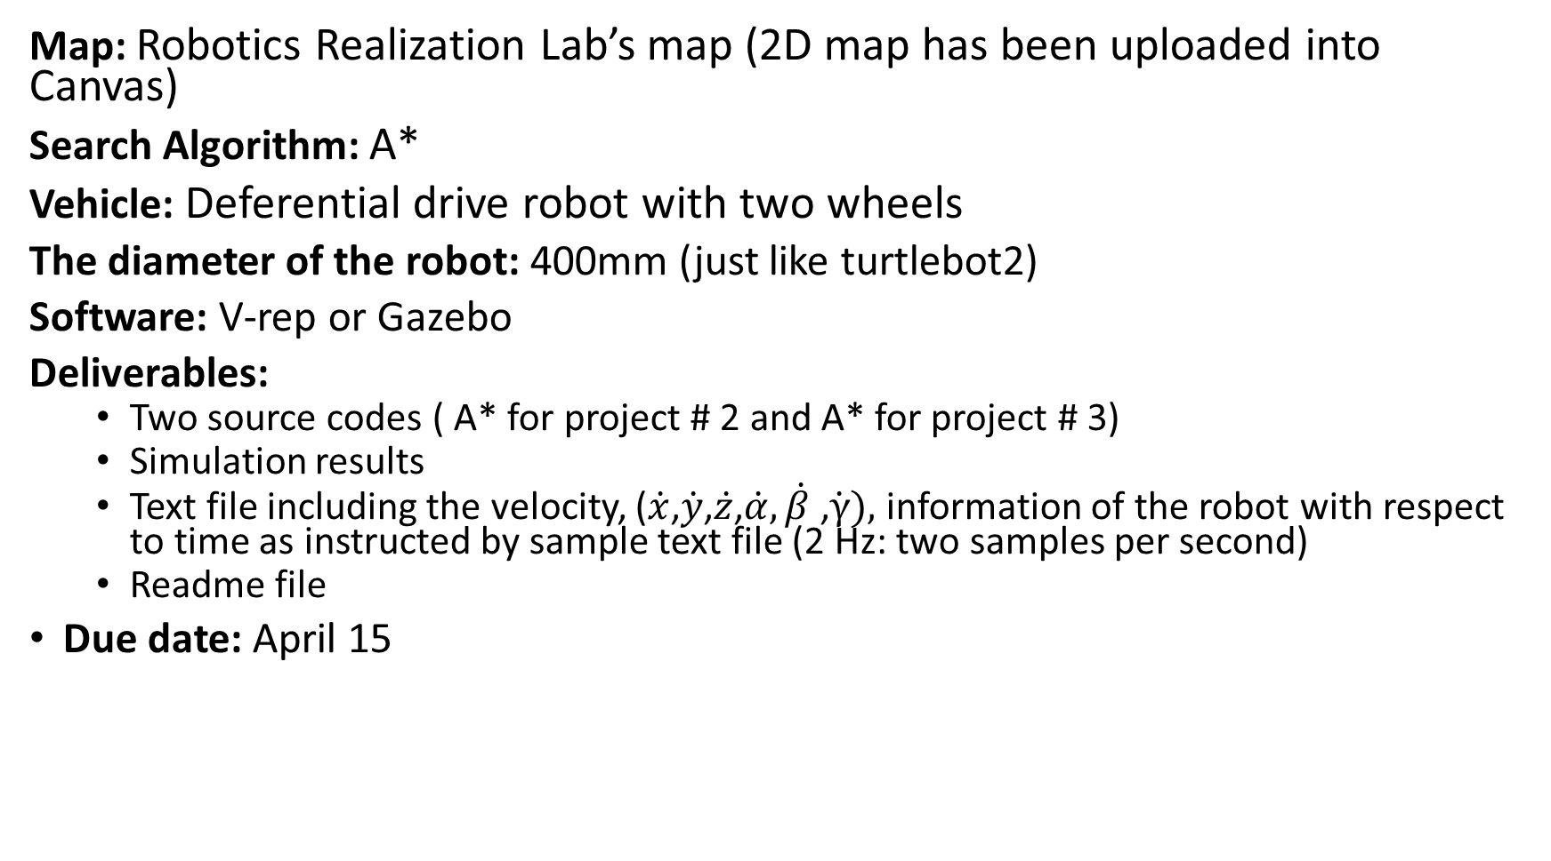
Project #3
Map: Robotics Realization Lab’s map (2D map has been uploaded into Canvas)
Search Algorithm: A*
Vehicle: Deferential drive robot with two wheels
The diameter of the robot: 400mm (just like turtlebot2)
Software: V-rep or Gazebo
Deliverables:
Two source codes ( A* for project # 2 and A* for project # 3)
Simulation results
Text file including the velocity, ($\dot{x}$,$\dot{y}$,$\dot{z}$,$\dot{α}, \dot{β}$ ,$\dot{γ}),$ information of the robot with respect to time as instructed by sample text file (2 Hz: two samples per second)
Readme file
Due date: April 15

Slide 3
Rubric
1- Implementing A* for project 2 (source code) : 2 points
2- Implementing A* for differential drive vehicle (source code with proper commenting): 5 points
3- Left wheel’s and right wheel’s rotational velocity in a txt file: 3 Points
4- Readme.txt file with instruction : 1 point
5- Implementation on real robot (Turtlebot): 4 points
Note: Students who prefer to implement project 4 on real robot (Baxter) can ignore step 5

